Slide 1
A note about this workshop
We have provided the following slides to use in meetings with faculty, advisors, and other important groups at your college to make the case for MMA reform.
We hope that you will customize the slides to serve your institution’s needs. Feel free to hide or alter slides and add branding that represents your college. Several slides are included to customize with your college’s data.

Slide 2
Information for facilitators
The notes below the slides include both instructions and speaker notes:
Instructions explain how to customize the slide for your audience.
Speaker notes provide additional context or information on the content of the slide. If there are no suggestions, present the slide as written, and include your own explanations.

Slide 3
Making the
Case for
Multiple Measures Assessment
Notes:
Instructions: Customize these slides – including the title of the presentation – for the audience at your college!

Slide 4
Colleges have traditionally used standardized tests to place students into courses
Students arrive at college with different levels of academic preparation.
Tests provide a simple and efficient way to place students into developmental or college-level courses.
Typical tests include:
Accuplacer and Compass
SAT and ACT
Homegrown tests

Slide 5
Placement tests are poor predictors of college readiness
Research shows that placement test systems put many students into developmental courses who could succeed in college-level courses.
Tests may reinforce cultural and racial biases.
Test content may not align with what students need to know for their majors or careers.
Source: Improving the Targeting of Treatment: Evidence From College Remediation

Slide 6
About MMA

Slide 7
To improve placement, colleges are increasingly using multiple measures assessment (MMA)
These colleges are considering several indicators of students’ readiness for college-level math and English, such as:
High school GPA
Standardized placement tests
Background questions
Course-taking history
Other assessments
The goal is to expand access to college courses by giving students several ways to demonstrate college readiness.

Slide 8
Expanding access helps students
Research has shown that prerequisite developmental courses don’t help many students prepare for success in college-level courses and sometimes hurt them, at least those near the college-level cutoff.
Source: What We Know About Developmental Education Outcomes

Slide 9
Placement reforms are one part of a larger developmental education reform movement
Traditional prerequisite approaches to developmental education delay enrollment in college-level courses, lengthen time to degree, and add to college costs.
These negative effects disproportionately affect Black, Latinx, and low-income students.
States and colleges are implementing corequisite support courses to replace prerequisite courses, revising math and English curricula, and taking other steps to reform developmental education.

Slide 10
Many colleges are introducing MMA and other reforms at the same time
MMA is compatible with other developmental education reforms, such as corequisite courses and math pathways.
In colleges that have eliminated prerequisite developmental courses, MMA can be used to place students into college-level courses with or without corequisite support.
Notes:
Speaker notes: In a corequisite developmental model, students who need extra support take college-level courses along with a learning support class, tutoring, or other supplemental instruction. Math pathways enable students to take different paths through the math curriculum so the math they learn is relevant to their course of study.

Slide 11
Why are we doing MMA?
Notes:
Instructions: Customize this slide for your college. Are you responding to a state mandate? Is it a college initiative?

Slide 12
Research on MMA

Slide 13
What does the research tell us about high school GPA?
Notes:
Speaker notes: High school GPA is the most important measure in most multiple measures assessment systems. We’re going to look at why that is.

Slide 14
High school GPA is the most predictive placement measure
High school GPA has much more predictive power than any standardized placement test scores.
Research shows that its predictive power holds up for several years after high school graduation and across high schools.
11th-grade GPA and self-reported high school GPA are nearly as predictive as final high school GPA and are more easily available.
Combining additional measures with GPA can marginally improve predictive power, but a simple placement system can even use high school GPA alone.
Source: Bostian, 2016; Hayward, 2020
Notes:
Speaker notes: Not all students have access to their high school GPAs. In those cases, colleges can use self-reported GPA or consider an informed self-placement system.

Slide 15
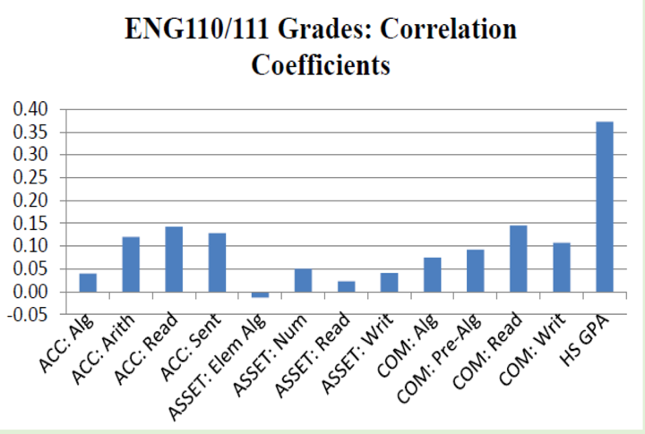
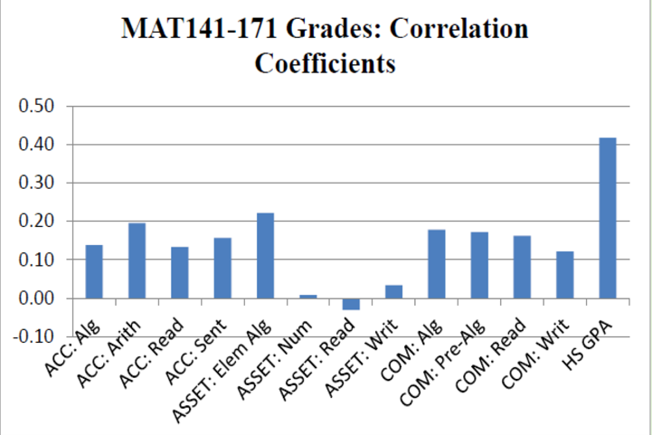
High school GPA is more predictive than standardized placement tests
From Bostian, 2016, North Carolina Waves GPA Wand, Students Magically College Ready; adapted from research of Belfield & Crosta (2012)
Notes:
Speaker notes: Is high school GPA a good predictor of student success?
To understand the predictability of high school GPA as compared to standardized placement tests, researchers calculated the correlation between various placement indicators and students’ grades in college-level courses. The placement indicators considered by this study included various subtests from Accuplacer, ASSET (a state-specific placement test), and Compass, as well as high school GPA.
In the figures above, the height of each bar represents the correlation between college-level grades and the corresponding placement indicator. The higher the bar, the more predictive the measure.
In both English and math, high school GPA was found to be much more highly correlated with student achievement as compared to any of the subtests considered.
These results suggest that placement systems that use high school GPA will, on average, do a better job at predicting students’ probability of success in the college-level course than systems that use standardized placement tests alone.

Slide 16
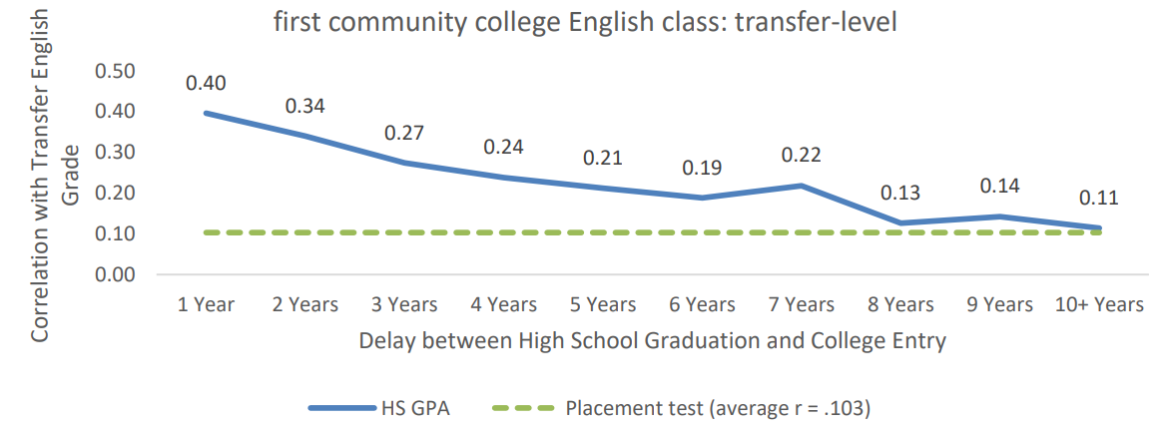
High school GPA is a better predictor than test results for a long time: English
Source: Hayward, 2020
Notes:
Speaker notes: How long is high school GPA a valid predictor of student capacity and achievement?
To investigate the “shelf life” of high school GPA as a predictor of success in college-level English and math, researchers used transcript and placement data to determine whether the predictive validity—or the extent to which high school GPA predicts grades in college coursework—is affected by the amount of time between high school graduation and college entry.
The results presented on this slide lend insight into the ability of high school GPA to predict grades in college-level English.
Specifically, this figure compares the predictive validity of Accuplacer and high school GPA for up to 10 years after high school graduation.
The solid blue line shows the correlation between high school GPA and grade earned in the first college-level English class relative to the amount of time that has passed since high school graduation.
The dotted green line shows the correlation between Accuplacer score and grade earned in the first college-level English class.
Although the predictive validity of high school GPA decreases over time, the correlation between high school GPA and course performance in English is greater than or equal to the correlation between Accuplacer scores and course performance for at least 10 years following high school graduation.

Slide 17
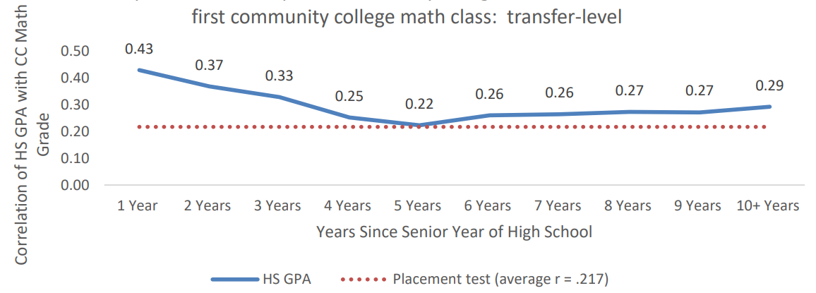
High school GPA is a better predictor than test results for a long time: Math
Source: Hayward, 2020
Notes:
Speaker notes: The results presented on this slide lend insight into the ability of high school GPA to predict grades in college-level math.
Specifically, this figure compares the predictive validity of Accuplacer and high school GPA for up to 10 years after high school graduation.
The solid blue line shows the correlation between high school GPA and grade earned in the first college-level math class relative to the amount of time that has passed since high school graduation.
The dotted red line shows the correlation between Accuplacer score and grade earned in the first college-level math class.
Although the predictive validity of high school GPA decreases over time, the correlation between high school GPA and course performance in math is greater than or equal to the correlation between Accuplacer scores and course performance for at least 10 years following high school graduation.

Slide 18
Do differences in grading across high schools impact the reliability of high school GPA?
Using data from North Carolina, researchers compared the difference between students’ average college GPA and their average high school GPA for students from the same high school district.
Relative to students’ high school GPA, students’ college GPAs decreased by about the same average amount regardless of where students attended high school.
These results suggest that differences across high schools should not be a major cause for concern when using high school GPA as a predictor of success in college-level English and math.
Source: Bostian, 2016

Slide 19
What happens when MMA changes student placements?

Slide 20
Recent CAPR research on MMA: Study 1
One CAPR study examined an algorithm-based placement system at community colleges in the State University of New York (SUNY) that combined several measures into a formula that weighted them by predictive power.
The measures in the algorithm included:
Placement test scores
High school GPA
Years since high school graduation
Students could be bumped up from developmental to college-level courses or bumped down from college-level to developmental courses. Many students’ placements stayed the same.
Source: Evaluation of Alternative Placement Systems and Student Outcomes
Notes:
Speaker notes: The Center for the Analysis of Postsecondary Readiness, or CAPR, is a research partnership between the Community College Research Center (CCRC) and MDRC. CAPR researchers have done two major randomized controlled trials on multiple measures assessment.

Slide 21
Recent CAPR research on MMA: Study 2
A second study looked at a simpler systems of decision rules at community colleges in Minnesota and Wisconsin
In the decision-rule systems, colleges considered:
Placement test scores
High School GPA
LASSI or Grit scores
Students who missed the cutoff for college-level courses on a placement test could qualify based on other measures
No students were bumped down in Minnesota and Wisconsin
Source: Multiple Measures Assessment Project

Slide 22
Increasing access to college-level courses using MMA improves outcomes
Students in both studies who were bumped up from developmental to college-level courses were about 10 percentage points more likely to complete college-level courses after three semesters than similar students in the control group who were not bumped up.
SUNY students bumped down from college-level to developmental courses were less likely to complete college-level courses.
Notes:
Speaker notes: The results from New York led to the recommendation that multiple measures systems should only bump students up.

Slide 23
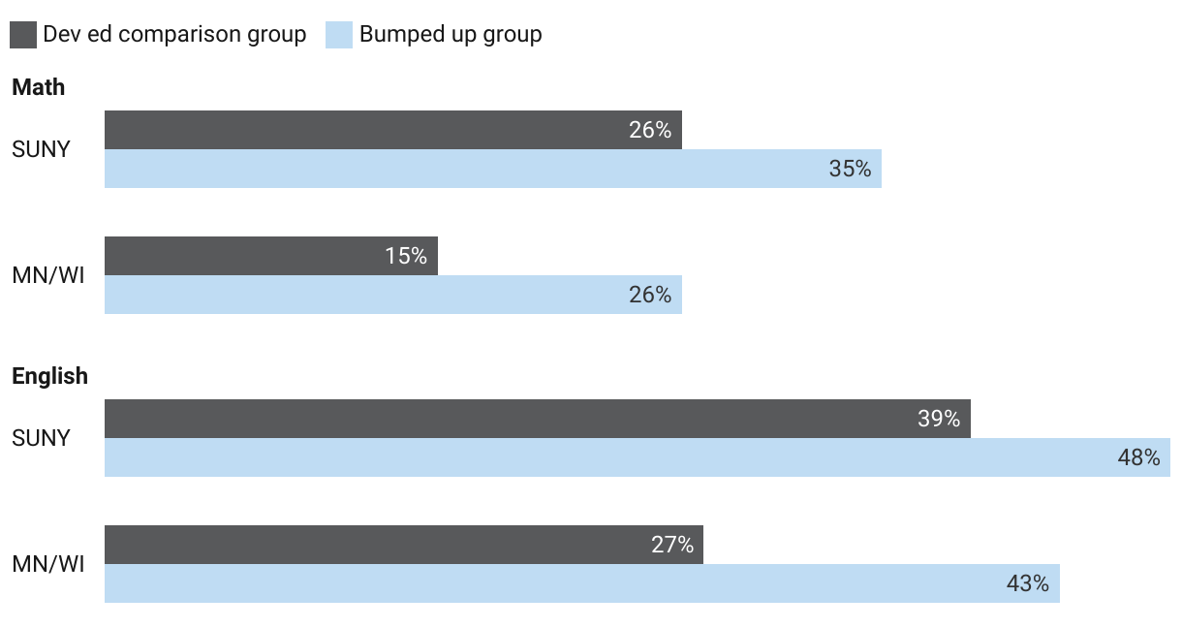
College-level course completion rates for students bumped up via MMA compared with similar students placed in dev ed
Note: Results from three semesters after placement. Source: Lessons From Two Experimental Studies of Multiple Measures Assessment

Slide 24
College-level course completion rates decreased for SUNY students bumped down to developmental courses
Source: Who Should Take College-Level Courses? Impact Findings From an Evaluation of a Multiple Measures Assessment Strategy

Slide 25
MMA can improve equity
English
Enrollments and completions in college-level courses increased significantly for bumped-up students across all subgroups defined by race/ethnicity, gender, and Pell status
Math
In Minnesota and Wisconsin, enrollments and completions increased for bumped-up students
In New York, men and students of color did not see significant impacts on completion of college-level courses

Slide 26
Recommendations based on the research
Create an MMA system that:
bumps many students up from developmental courses to college-level courses and avoids bumping students down
emphasizes high school GPA and other transcript information, allowing the use of widely available measures such as self- reported high school GPA
is relatively simple to implement, with decision rules based on cutoffs on a few measures
Source: Lessons From Two Experimental Studies of Multiple Measures Assessment

Slide 27
MMA at our college

Slide 28
Our data

Slide 29
What does our data show?
Notes:
Instructions: On this and subsequent slides, put:
The percentage of all testing students enrolling in college-level math and English courses within three semesters; Demographic breakdowns of these percentages.
The percentage of students placed in college-level math and English courses that complete with a C or higher within three semesters.
The percentage of students placed in developmental math and English courses that complete college-level math and English with a C or higher within three semesters.
Other useful analyses from the tool What to Look for In Your Institution’s Data.

Slide 30
Next steps and timeline
Notes:
Instructions: Customize this slide to explain what happens next at your college and what you know about the timing.

Slide 31
How will MMA affect you?

Slide 32
Process/procedural changes by role for:
Faculty
Advisors
Administrators
Notes:
Instructions: Customize this section of the slide deck for the audience using information from the FAQs for faculty and staff and your planning discussions. Tools in the Planning section of the toolkit will also help you think through changes in staff roles and processes.

Slide 33
Other questions?

